Slide 1
Journal of Brief Ideas Kavli@10 hackathon session
David Harris
Stuart Lynn
Christopher Williams
Christopher Davis
Devon Powell
Chris Martin

Slide 2
A RELATION BETWEEN DISTANCE
AND RADIAL VELOCITY AMONG
EXTRA-GALACTIC NEBULAE
By EDWIN HUBBLE
PNAS
Communicated January 17, 1929

Slide 4
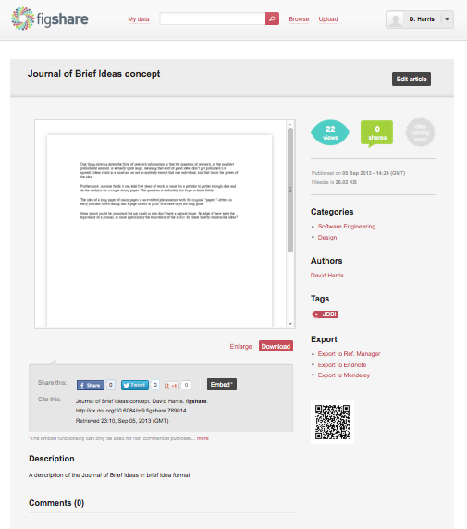
JOBI exists!
http://dx.doi.org/10.6084/m9.figshare.789014

Slide 5
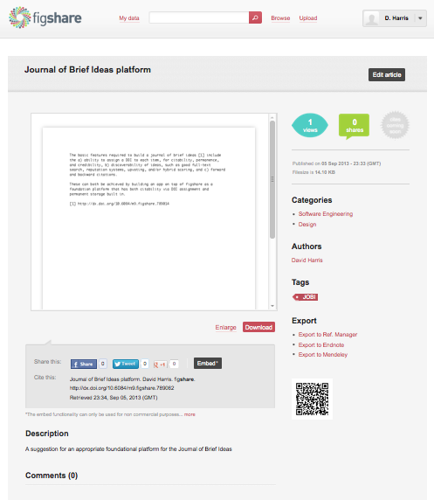
First reference!
http://dx.doi.org/10.6084/
m9.figshare.789062

Slide 6


Slide 7
